Slide 1
Seismic alarm systems:
1. Detect large events (Ml)‏
2. Detect swarms (events per hour, delta_t, 'cumulative' magnitude)‏
3. Detect tremor (RSAM/DR, SSAM, gliding lines)‏
4. Detect problems with automated data acquisition, alarm or archival systems.
RSAM alarm system provides 1 & 3. IceWeb alarm system also provides 3. Swarm alarm system provides 2.
Swarm alarm system:
- start of swarm
- escalation in swarm
- end of swarm
Generic alarm management system:
- able to handle any type of alarm that we want to send as an email / text message.
Tremor alarm system:
- base on IceWeb alarm system, but convert from MATLAB (not robust) to C or Python.
Diagnostic alarm system:
- ?

Slide 2
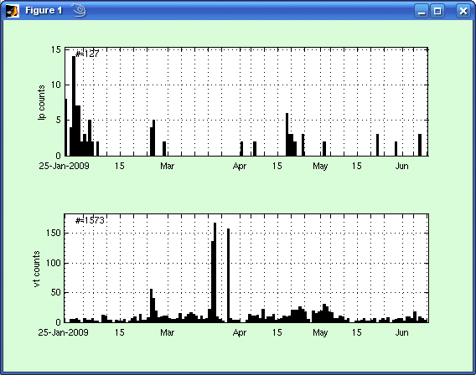
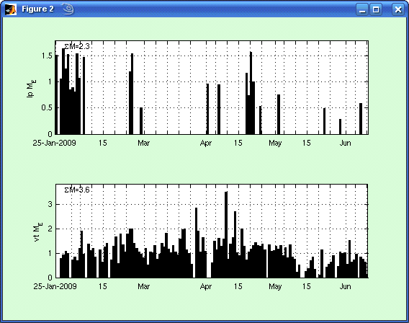
Official AVO catalog (Scott's picks)‏
binsize = 1 day
magnitude threshold = -1.0
5 km radius from summit
Counts
- 129 lp events from 1 Jan – 10 Jun
- 1576 vt events
Cumulative
(or equivalent)‏
magnitude
Algorithm:
- convert each magnitude to energy
- add energy
- convert total energy to magnitude
M_{cum} = 2.3 for lp events,
3.6 for vt events
Pros:
- good magnitudes, good locations
Cons:
- not real-time
- not good for swarms

Slide 3
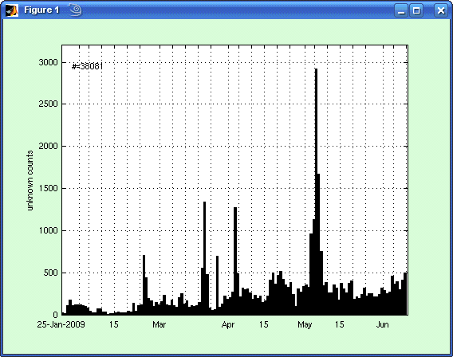
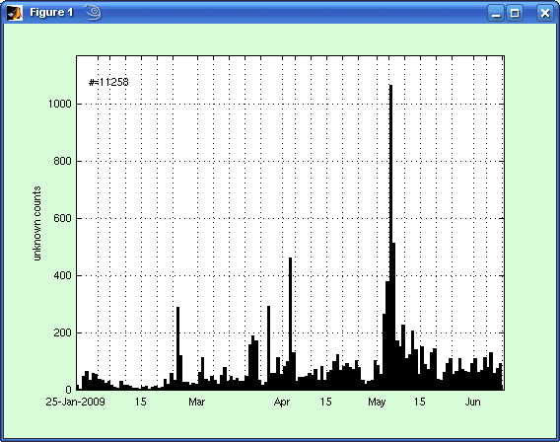
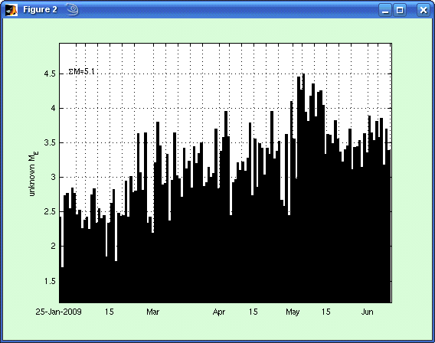
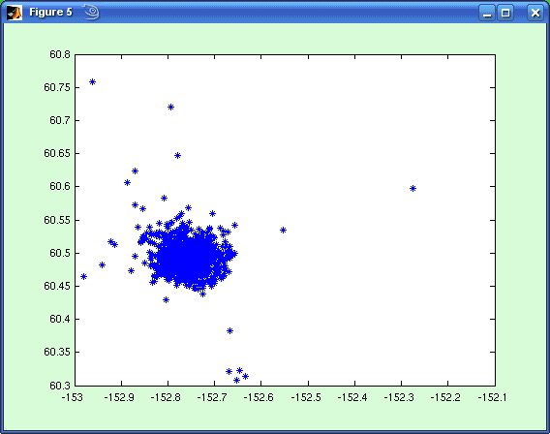
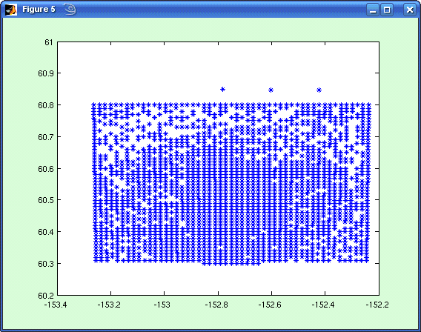
Real-time system (automated hypocenters, magnitudes)‏
all events
M >= 1.0
6 May
6 May
4 Apr
4 Apr
27 Mar
27 Mar
22 Mar
22 Mar
26 Feb
26 Feb
Pros:
38081 events, compared to 1700 from AVO catalog (22 times more)‏
works well for swarms
Cons:
locations / magnitudes horrible
no classifications
no data prior to 25 January (yet)‏

Slide 4
Swarm parameters (real-time catalog)‏
Date # #M>1 M_{cum} peakEventsPerHour
26-27 Feb 1267 442 3.7 94
20-23 Mar 2525 565 3.7 82
27 Mar 754 318 3.8 131
2-4 Apr 2038 688 4.1 101
3-7 May 7430 2393 4.8 205
swarm “equivalent” magnitude
Remarks:
magnitude threshold alters counts, but not energy/M_{cum}
swarms (small events) not well represented in AVO catalog, real-time catalog better
New tools:
- recompute magnitudes based on locations from AVO catalog / other work
- merge with VolPlot
- temporal/spatial (cylindrical shells?) b-values
- classifications for real-time catalog (frequency-index, neural network, Markov chains?)‏

Slide 5
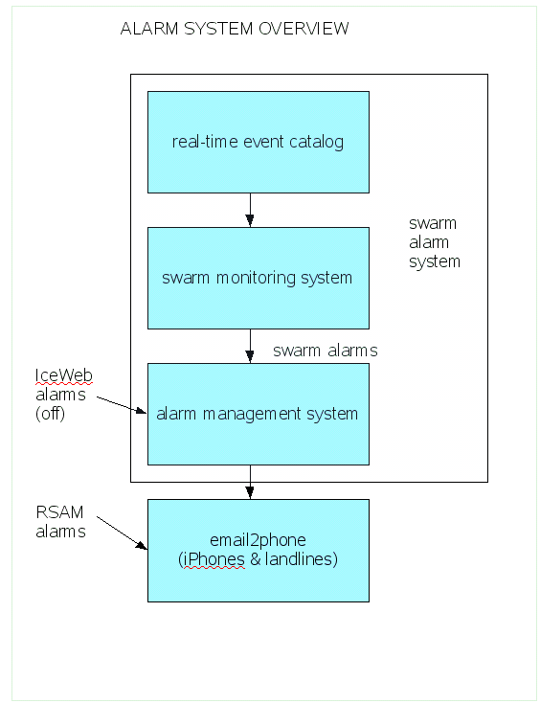

Slide 6
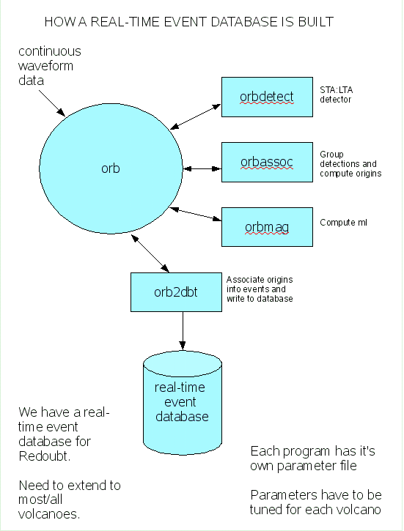
Redoubt real-time database contains ~25 times more events than analyst reviewed catalog.
Locations are not well constrained, but this should not greatly affect magnitude (at least will not compromise swarm alarms).
Events are unclassified. But we hope (one day) to automatically classify all events.
All sorts of additional tools and plots can be based on these databases.

Slide 7
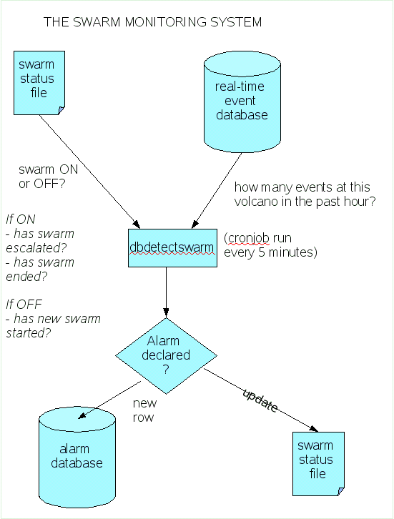
Once we have a real-time event “catalog”, it's trivial to see how many events there have been in the last hour, and what the magnitude of those events was.
So a program is run every 5 minutes to check the real-time event catalog.
The only other thing we need is to track the swarm status, so we can decide whether to check for a new swarm, or the escalation or end of a previously declared swarm.

Slide 8
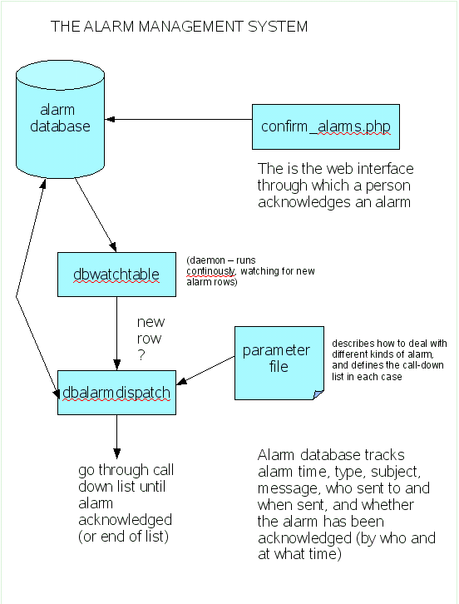
A program watches for new rows in the alarm database, and dispatches them via a call-down list defined in a parameter file.
The call-down is stopped if somebody acknowledges the alarm.
This generic alarm management system can handle any kind of alarm (they don't even have to be seismic).

Slide 9
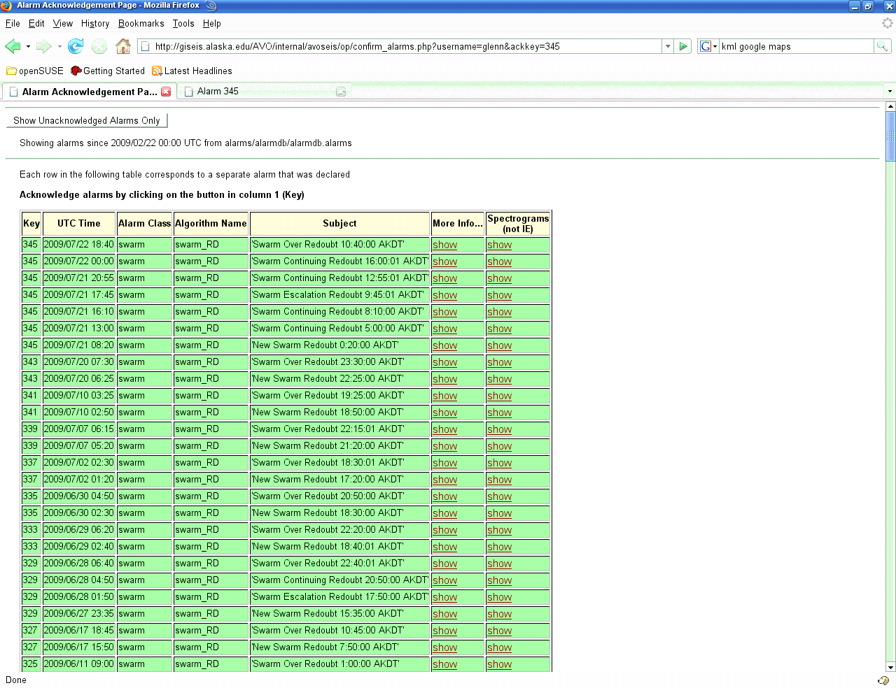
Each alarm declared is a separate row here.
Background color:
Green – acknowledged
Red – not acknowledged

Slide 10
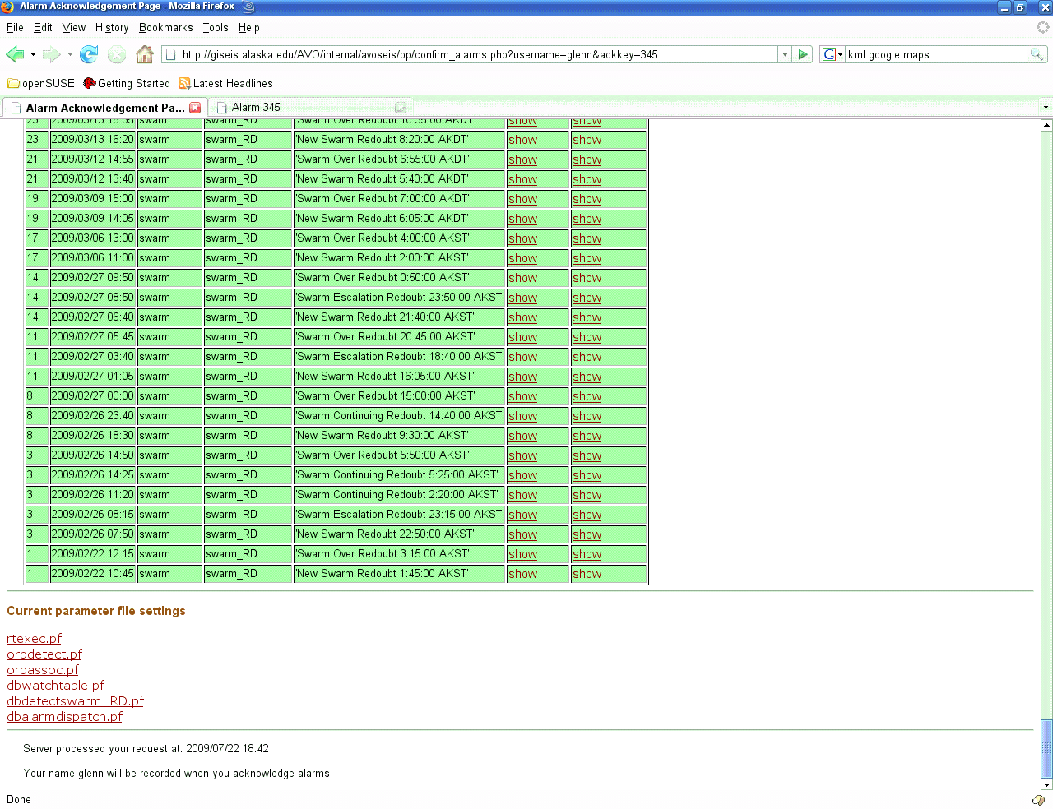
Live parameter file settings are here including call-down list

Slide 11
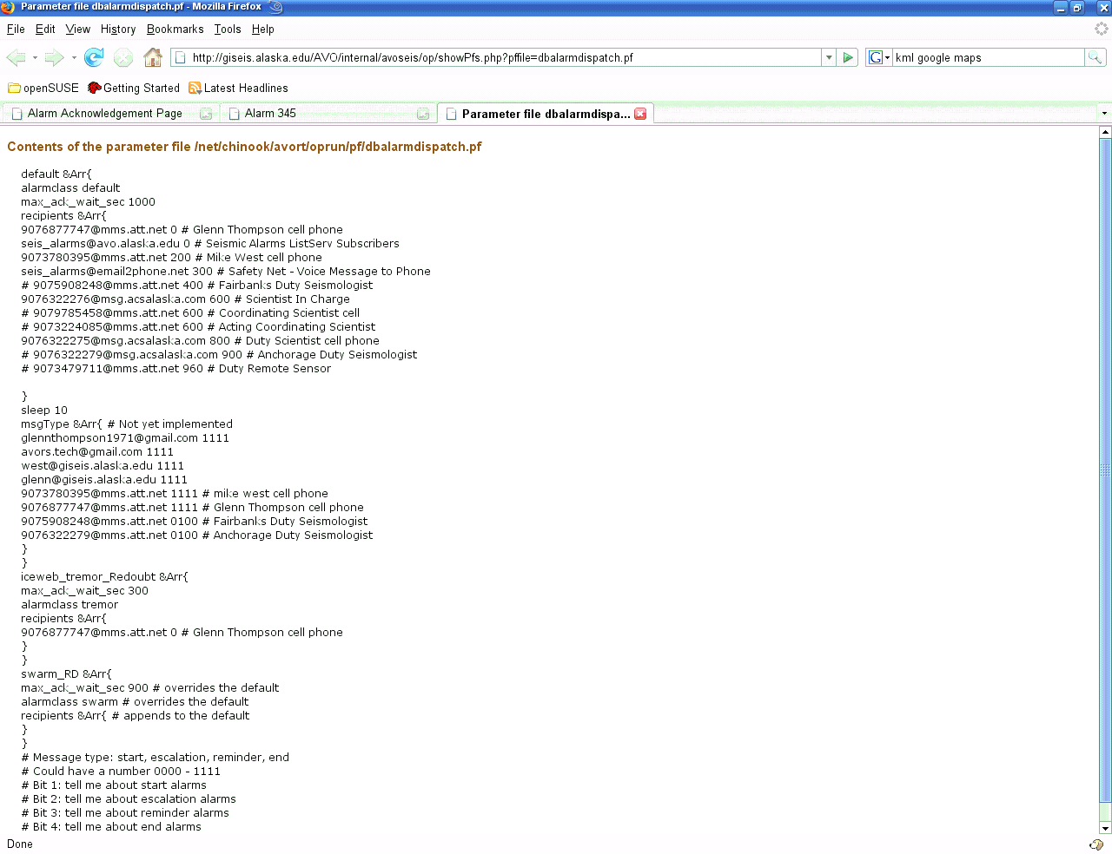
Call-down:
Seconds Recipient
0 Glenn's cell
0 seis_alarms@avo.alaska.edu
200 Mike West cell
300 seis_alarms@email2phone.net
600 Scientist In Charge cell
800 Duty Scientist cell
seis_alarms@avo.alaska.edu is a Listserv sign-up for people who just want to receive emails of seismic alarms.
seis_alarms@email2phone.net is a 3rd party commercial service that allows us to call iPhones and landlines (more on this later).

Slide 12
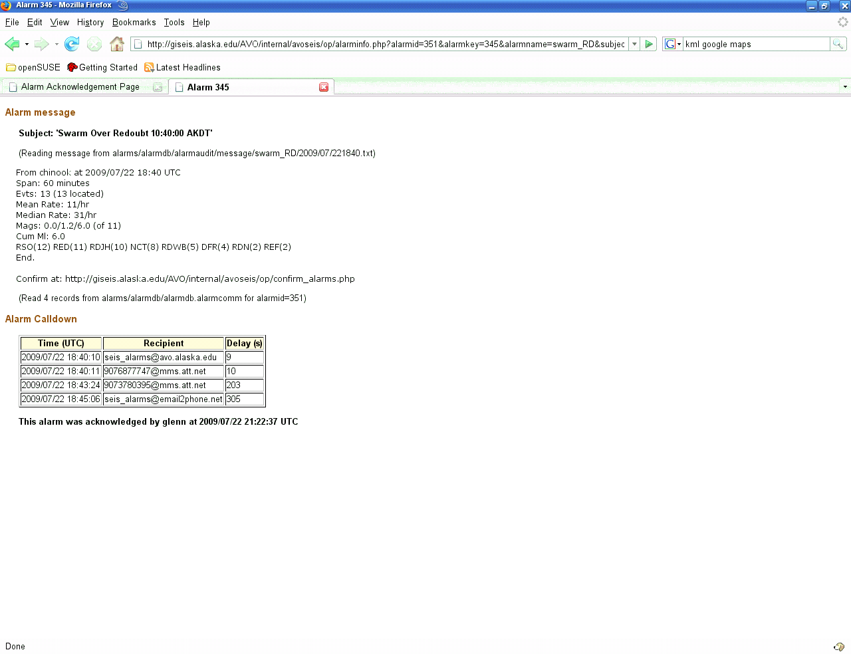

Slide 13
EMAIL2PHONE
Text messages (SMS/MMS) to (regular) cellphones are great.
However:
1. iPhone only allows a barely audible sound when text message arrives – not going to wake anyone. iPhones do have loud/long ringtones – so we want to call them instead of texting them.
2. Cannot send text message to landline. Landlines are a great way to reach people at night because: (a) cellphones may be dead/mislaid/off/out of range, and (b) landlines ring loudly.
We are trying a service called email2phone.net. It turns emails sent to seis_alarms@email2phone.net into voice messages. It can call up to 20 phone numbers, until someone picks up the phone and answers. It costs $10/month.
RSAM alarms are currently going to seis_alarms@email2phone.net.
So are swarm alarms if they have not been answered within 5 minutes.

Slide 14
Alarm messages
RSAM message
Swarm alarm message
From: iceweb@giseis.alaska.edu
Subject: New Swarm Redoubt 12:20:00 AKDT
From chinook at 2009/07/22 20:20 UTC
Span: 60 minutes
Evts: 38 (38 located)‏
Mean Rate: 30/hr
Median Rate: 59/hr
Mags: -0.2/0.6/1.8 (of 30)‏
Cum Ml: 2.1
RED(35) NCT(29) RSO(29) RDJH(19) DFR(14) RDWB(14) REF(10) RDN(7)‏
End.
From MakushinWorm@usgs.gov
Subject RSAM event Redoubt 07/17/2009 05:47:03
ANC Makushin reports
RSO:EHZ:AV_ data= 20/ 600
REF:EHZ:AV_ data= 39/ 500
RED:EHZ:AV* data= 621/ 200
Designed for text message / email. Not well structured for conversion to voice message.

Slide 15
REQUIREMENTS
Alarm systems need to be highly robust:
Should be run on two different computers, providing failover capability (ideally one in Anchorage, one in Fairbanks)‏
Should have an individual, well-maintained UPS, to protect against brown-outs.
Should auto-reboot following a power outage.
A diagnostic alarm should monitor all potential points of failure of all mission critical systems.

